Slide 1



COMMON OBJECT REQUEST
BROKER ARCHITECTURE (CORBA)
Zohaib Ali Singay
Subhan Amjad
Aqsa Saeed
Noor Fatima
Presented by:

Slide 2
INTRODUCTION
Better Use of Distributed Systems
Different Programming Languages
Complex Computing Environment
Applications Of Different Environments

Slide 3
HISTORY
In the Late 1980s - Early 1990s
Founding of Object Management Group
Object Management Group (OMG) in 1989
Development of CORBA

Slide 4
ARCHITECTURE
Object Request Broker (ORB)
Interface Definition Language (IDL)
Client and Server Stubs
Portable Object Adapter (POA)
CORBA Services

Slide 5


WORKING
LETS SEE THE WORKING OF CORBA

Slide 6
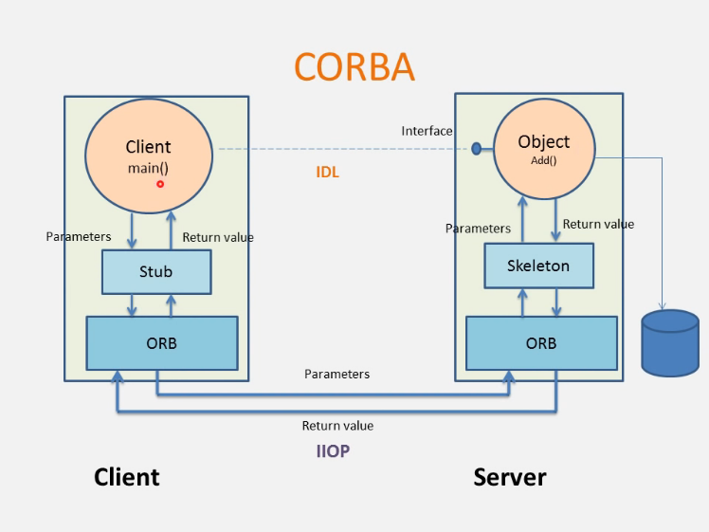

Slide 7
ADVANTAGES
Interoperability
Reusability
Language Independence
Platform Independence
Scalability

Slide 8
COMPLEXITIES
Complex Configuration
Deployment Complexity
Performance Overhead
Interoperability Issues
CONCLUSION

Slide 9




STUDIO SHODWE
CONCLUSION
+123-456-7890
hello@reallygreatsite.com
www.reallygreatsite.com
123 Anywhere ST., Any City, ST 12345
THANK YOU !!

Slide 10
CONCLUSION
THANK YOU !!

